Slide 1
Labwork #6
Simple Puzzle Game

Slide 2
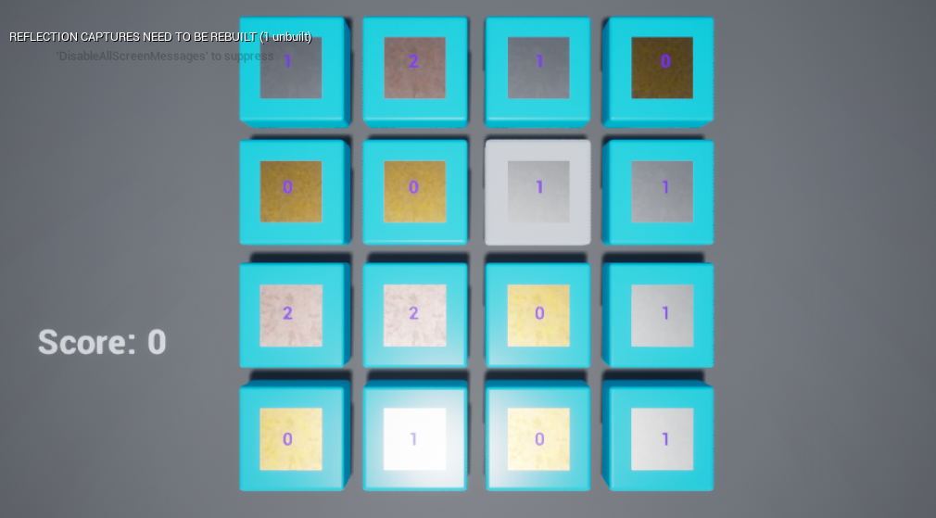
GAME CLASSES
The game created in this lecture is based on the Puzzle Game template. The game uses four main Blueprint classes:
PuzzlePlayerCharacter: A Pawn subclass that represents the player and is part of the Third Person template. This class is assigned to the Default Pawn Class parameter of the Game Mode. Under CharacterMovement component GravityScale is 0.0. So the player never falls on the ground.
PuzzleBlockGrid: An Actor class that is responsible to generate and destroy all puzzle blocks.
PuzzleBlock: Respresents one puzzle block with a different material / shape on it.
PuzzlePlayerController:Used to enable mouse click and hover events.

Slide 3
GAME MECHANICS
Player can click on the puzzle blocks and highlight them.
Each block has a different material representation: Gold, Copper and Nickel.
Highlighting 3 of the same type vertically or horizontally will destroy the selected blocks.
Player can highlight up to 3 blocks. If there is no match then selection is reset.
Every time blocks are destroyed, new random ones are spawned.
Every 2 seconds the whole blocks will randomly change materials.
During breaking animations randomly changing will pause and restart after the animation ends.

Slide 4
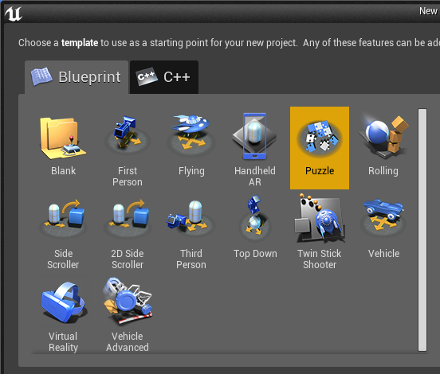
CREATING THE PROJECT
Create a new project using the Puzzle template with starter content.
In the Content Browser, browse to PuzzleBP/Blueprints folder.

Slide 5
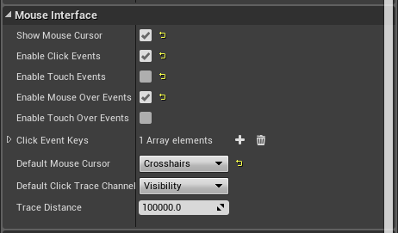
PUZZLEPLAYERCONTROLLER
Notice and make sure that
Show Mouse Cursor
Enable Click Events
Enable Mouse Over Events
are all checked.

Slide 6
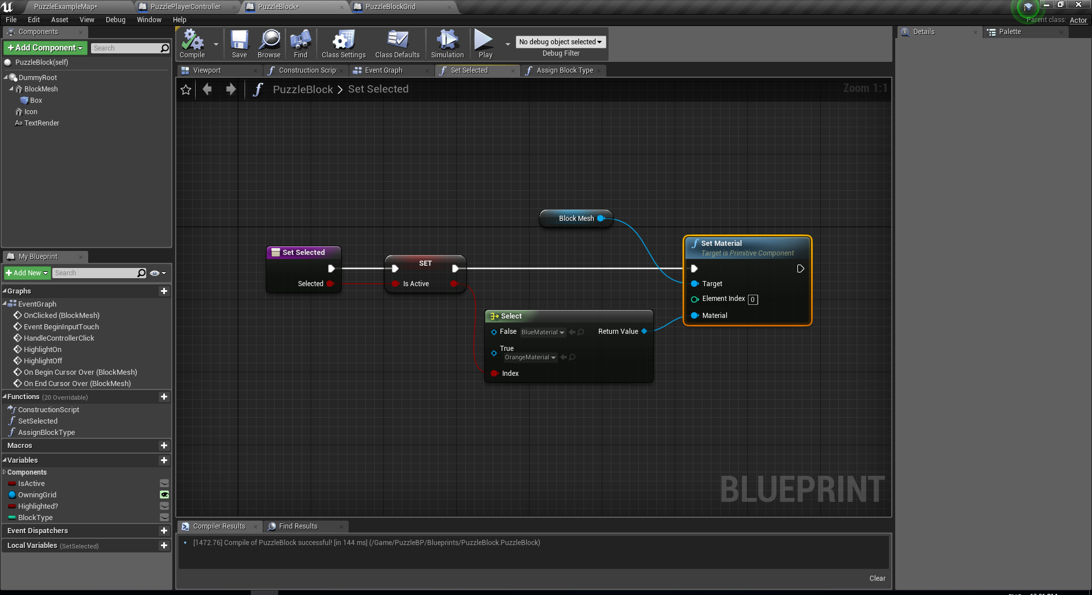
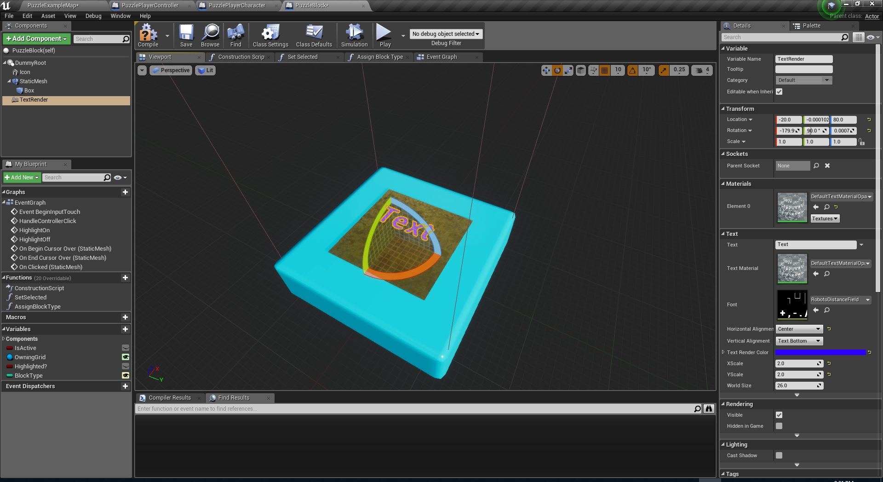
PUZZLEBLOCK
Add SetSelected function.
Add BlockType Integer variable.
Go to viewport and add 2 components under DummyRoot:
Icon (StaticMesh)
StaticMesh => Shape_Plane
Location => 0,0,60
Scale => 1.5,1.5,1.5
Text (TextRender)
Location=>-20,0,80
Rotation=> -180,90,0
Horizontal Alignment => Center
Collision Presets => No Collision

Slide 7
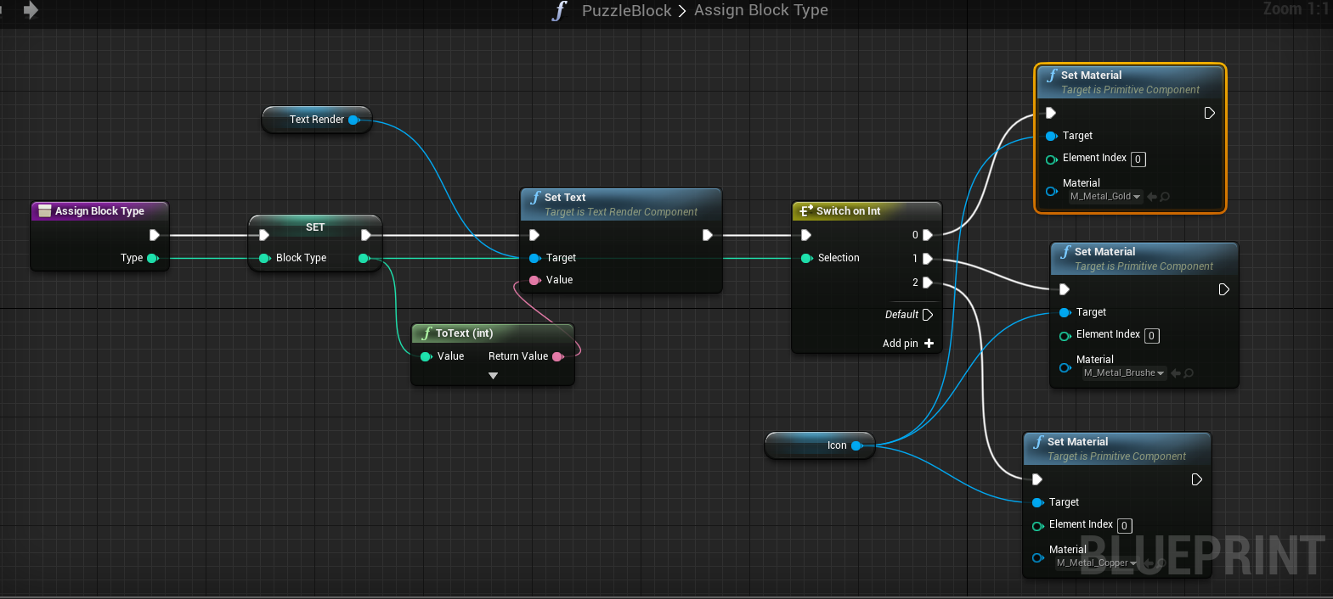
PUZZLEBLOCK
Add AssignBlockType function.

Slide 8
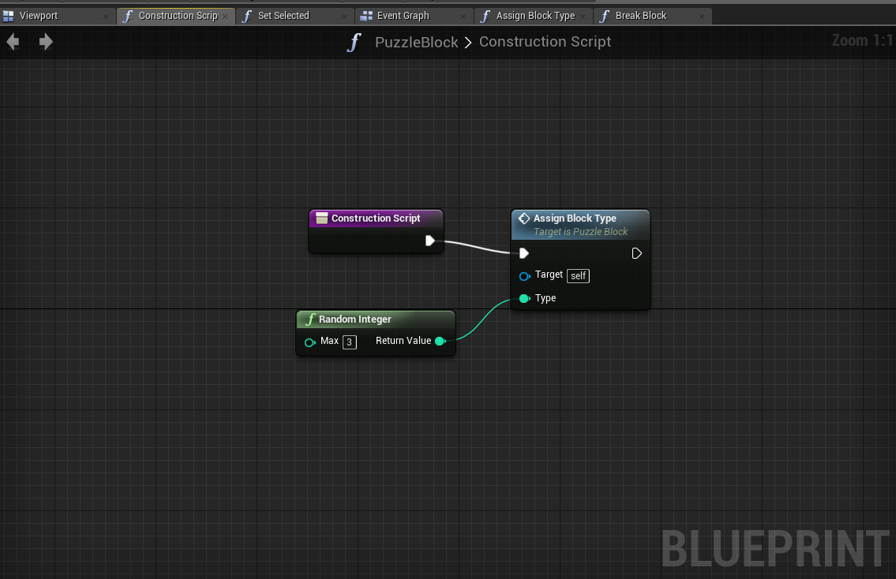
PUZZLEBLOCK
Implement the construction script.

Slide 9
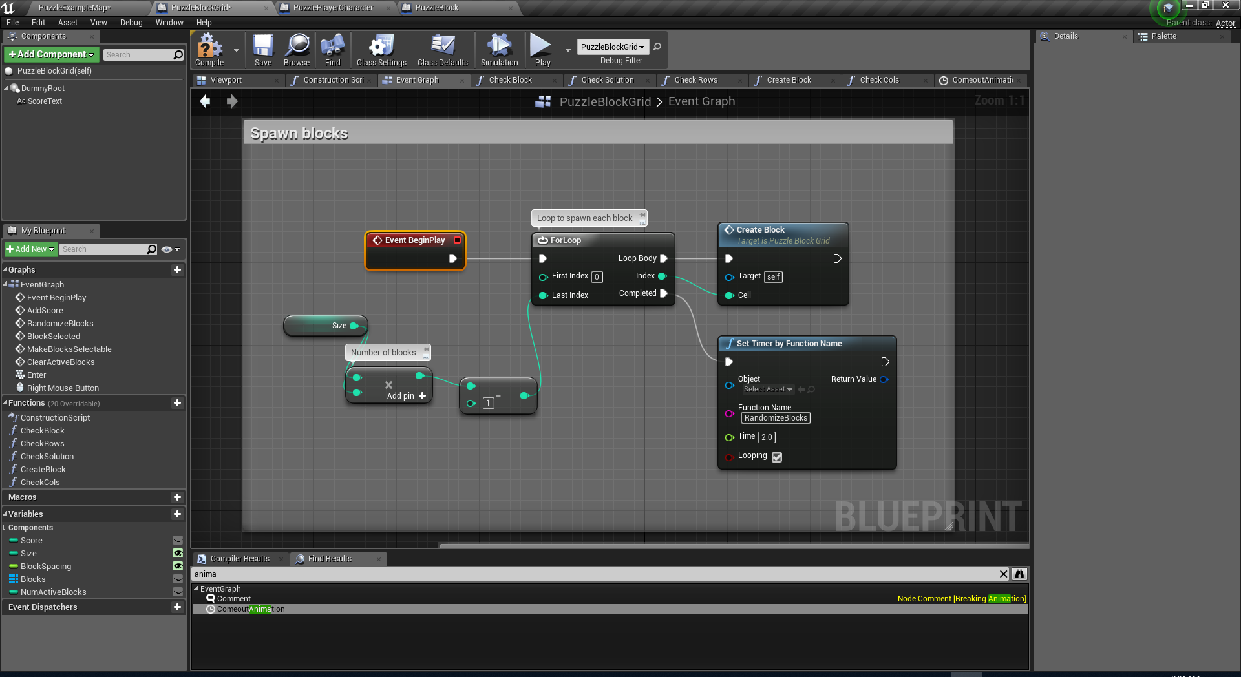
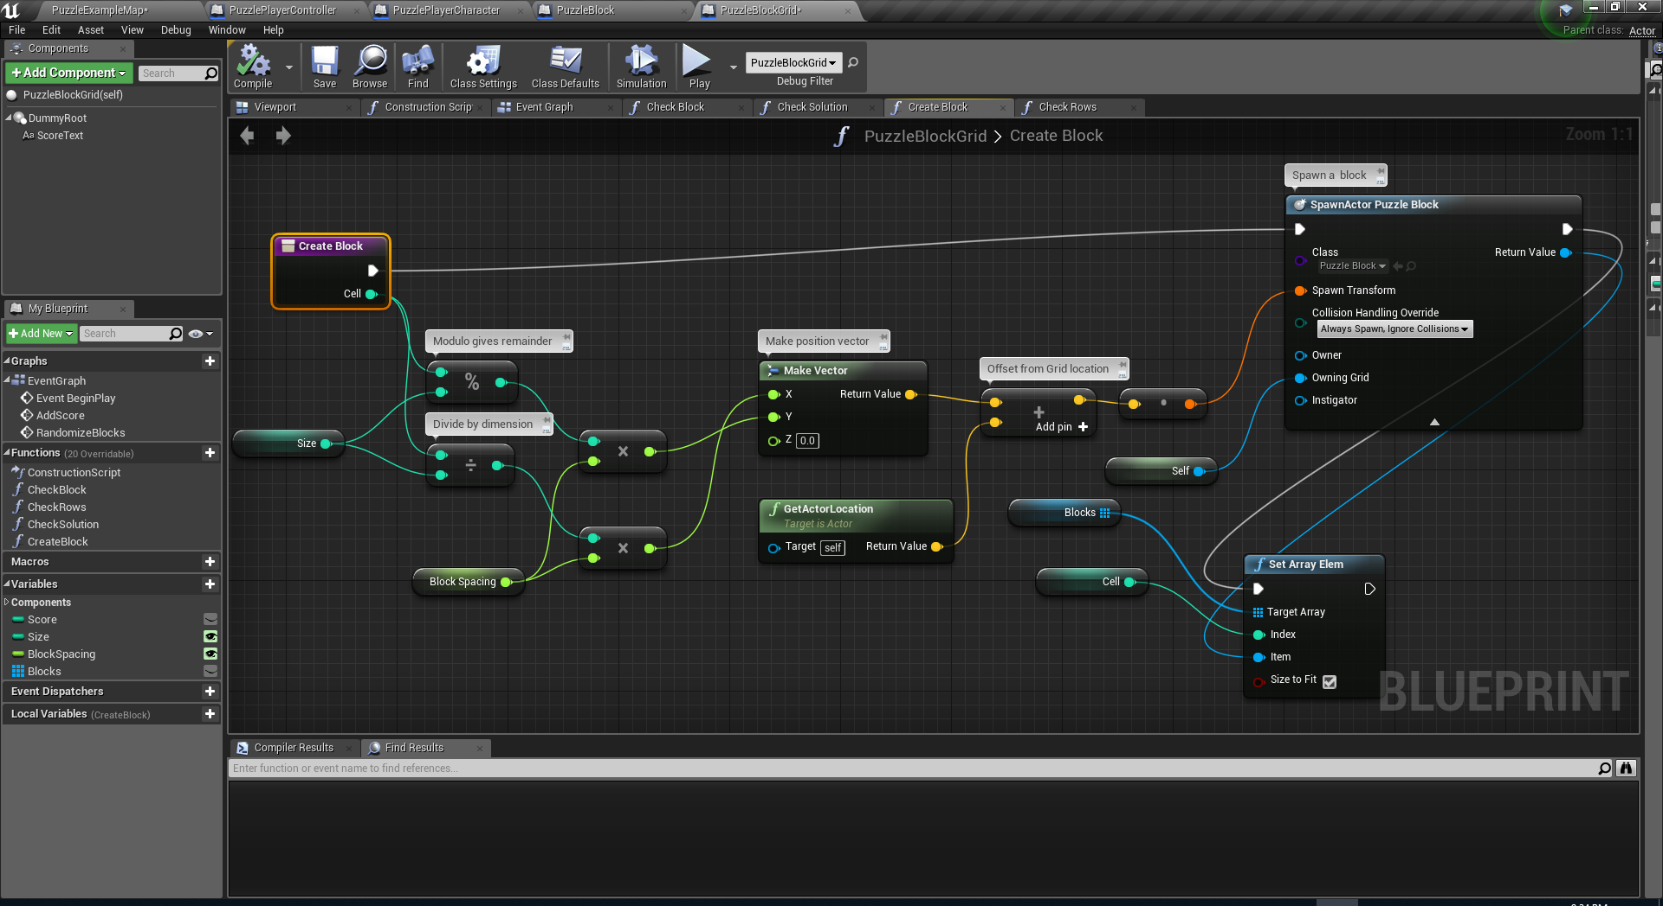
PUZZLEBLOCKGRID
Add Blocks Array variable of type PuzzleBlock.
Add CreateBlock function.
Change BeginPlay as shown.
Set the default value for the Size integer variable to 4. This will make our game to be played on a 4x4 grid.
New Node: Set Array Elem
Set the location of the CameraActor in the scene so that the camera will center on the grid area.
Location => (X=300,Y=130,Z=1200)

Slide 10
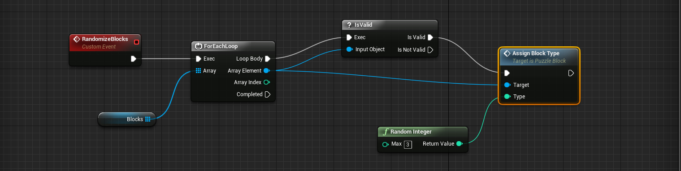
PUZZLEBLOCKGRID
Add RandomizeBlocks function.

Slide 11
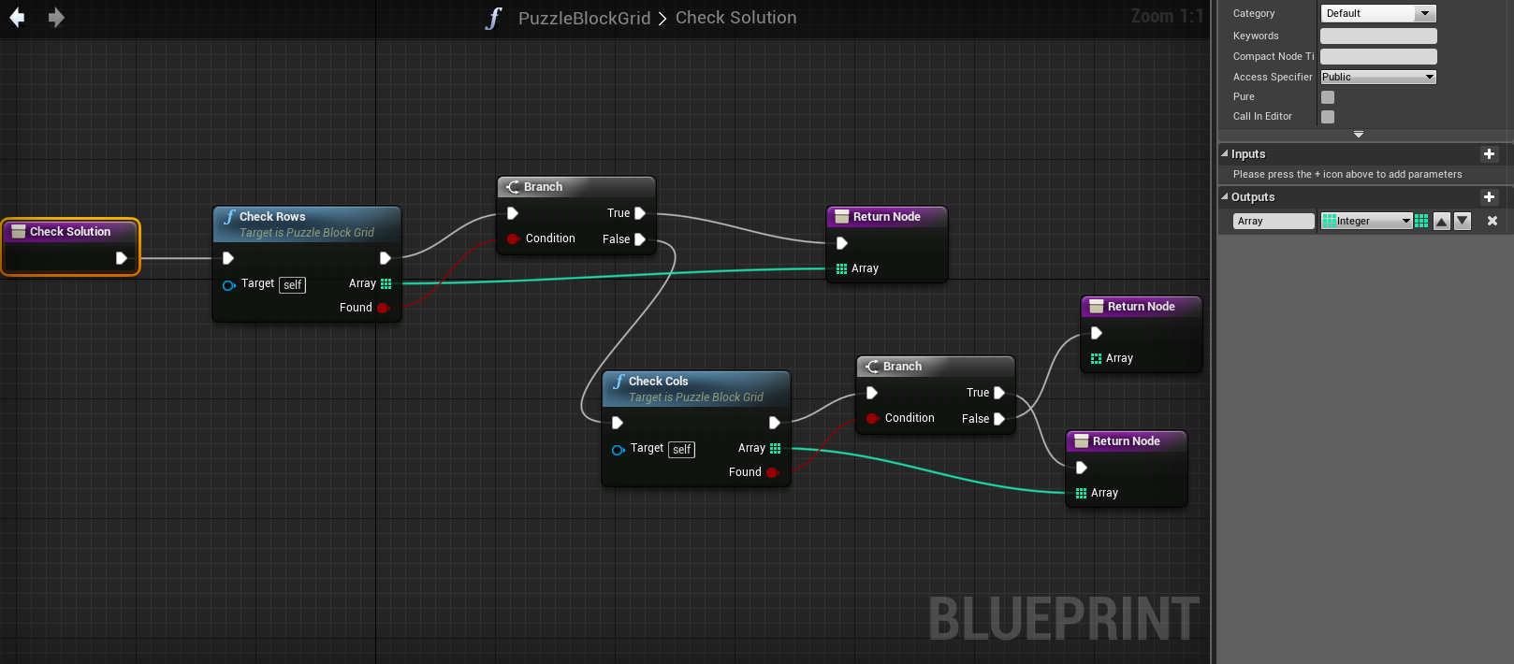
PUZZLEBLOCKGRID
Add CheckSolution function.
This function return an integer array for the blocks to be broken.
This function will check possible solutions whenever a player clicks on the blocks.
For start make the CheckRows and CheckCols functions and leave them empty.

Slide 12
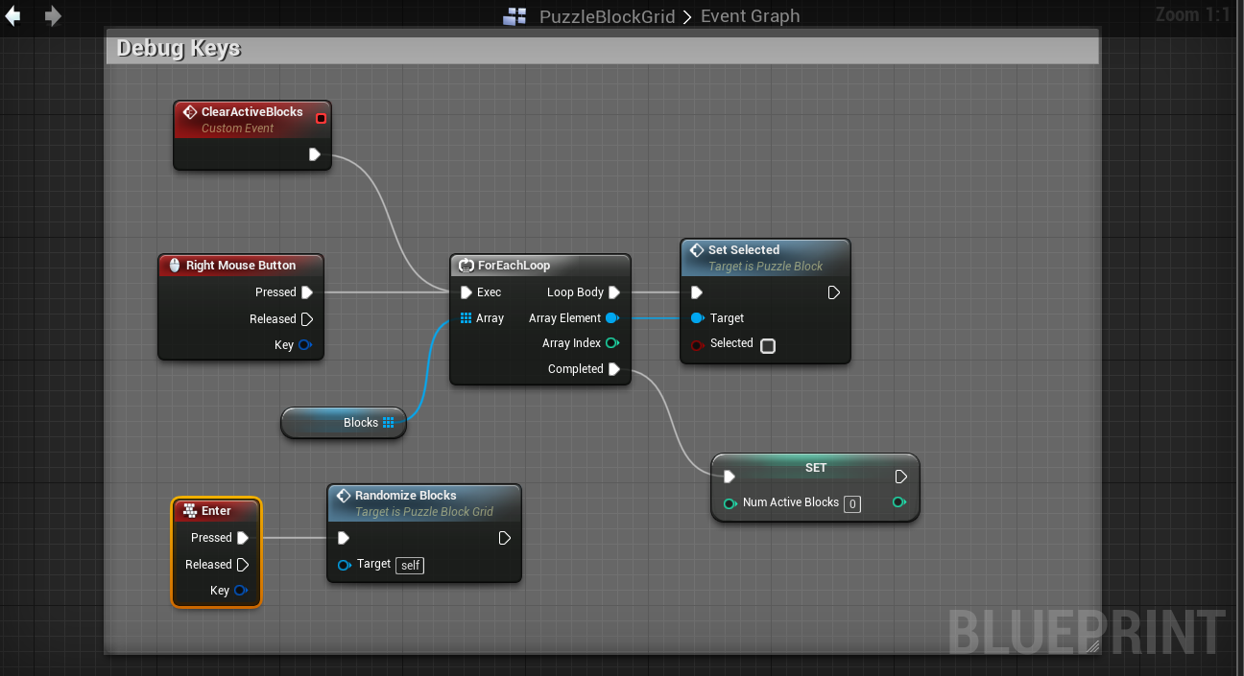
PUZZLEBLOCKGRID
Add a debug Enter key event for regenerating puzzle block types.
Right Clicking will also clear the selection on the blocks.
Add an Integer variable named NumActiveBlocks to hold the number of selected blocks.
Also add custom event ClearActiveBlocks and connect it to Right Mouse Click as well.

Slide 13
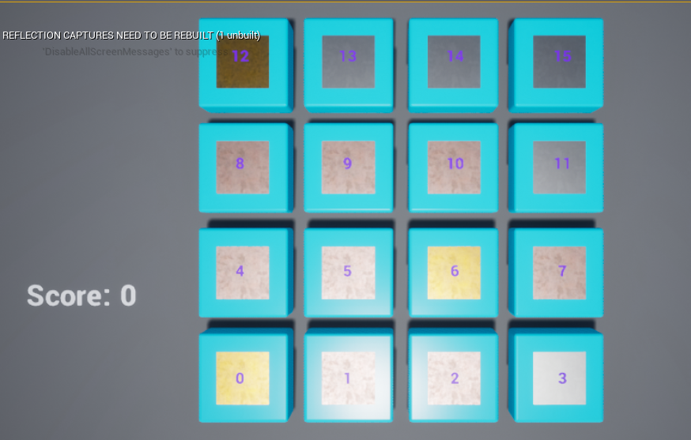
ARRAY SLOTS
This is how the BlockGrids are stored in Blocks Array of PuzzleBlockGrid.
Rows
(0-3)
Col | Row | Array Index
0 | 0 | 0
1 | 0 | 1
2 | 0 | 2
3 | 0 | 3
0 | 1 | 4
1 | 1 | 5
2 | 1 | 6
3 | 1 | 7
2 | 3 | 14
1 | 2 | 9
Cols (0-3)

Slide 14
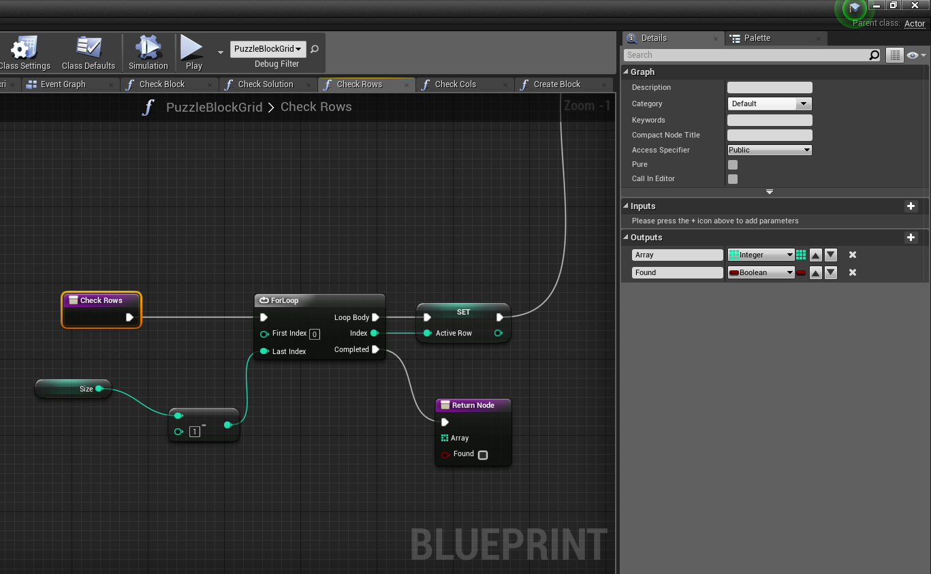
CHECK ROWS (1/5)
We will start checking each row for a solution. So the order will be like:
For Row 0:
Cols (0,1,2)
Cols (1,2,3)
For Row 1:
Cols (0,1,2)
Cols (1,2,3)
… etc
Rows will be increasing from 0 to 3.
(= from 0 to Size-1)
For every row, cols will be check from 0 to 1. (= from 0 to Size-3)
Size = 4!
CheckRows() return an Integer array and a Boolean.
Array: List of array indices containing the blocks to be destroyed.
The integer values are direct indices to Blocks array.
Found: Did we find a solution?

Slide 15
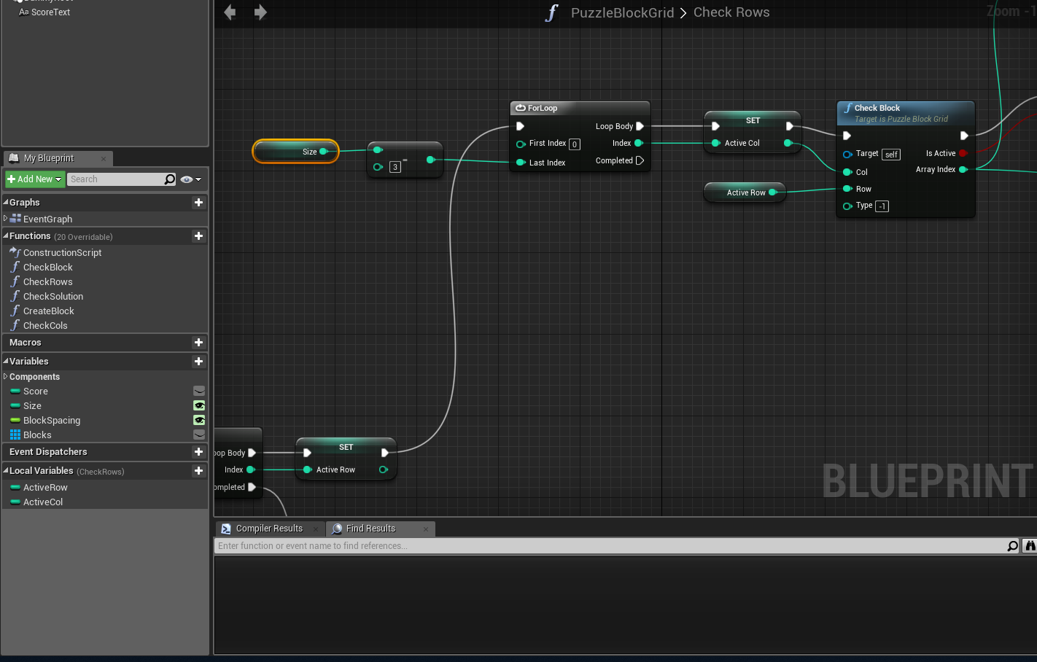
CHECK ROWS (2/5)
Add to Local Variables to CheckRows:
ActiveRow and ActiveCol
Add the 2nd inner loop for interating Coloumns from 0 to Size-3
Add CheckBlock to check the contents of the blocks at the corresponding [Row,Col] pair.
Set ActiveCol

Slide 16
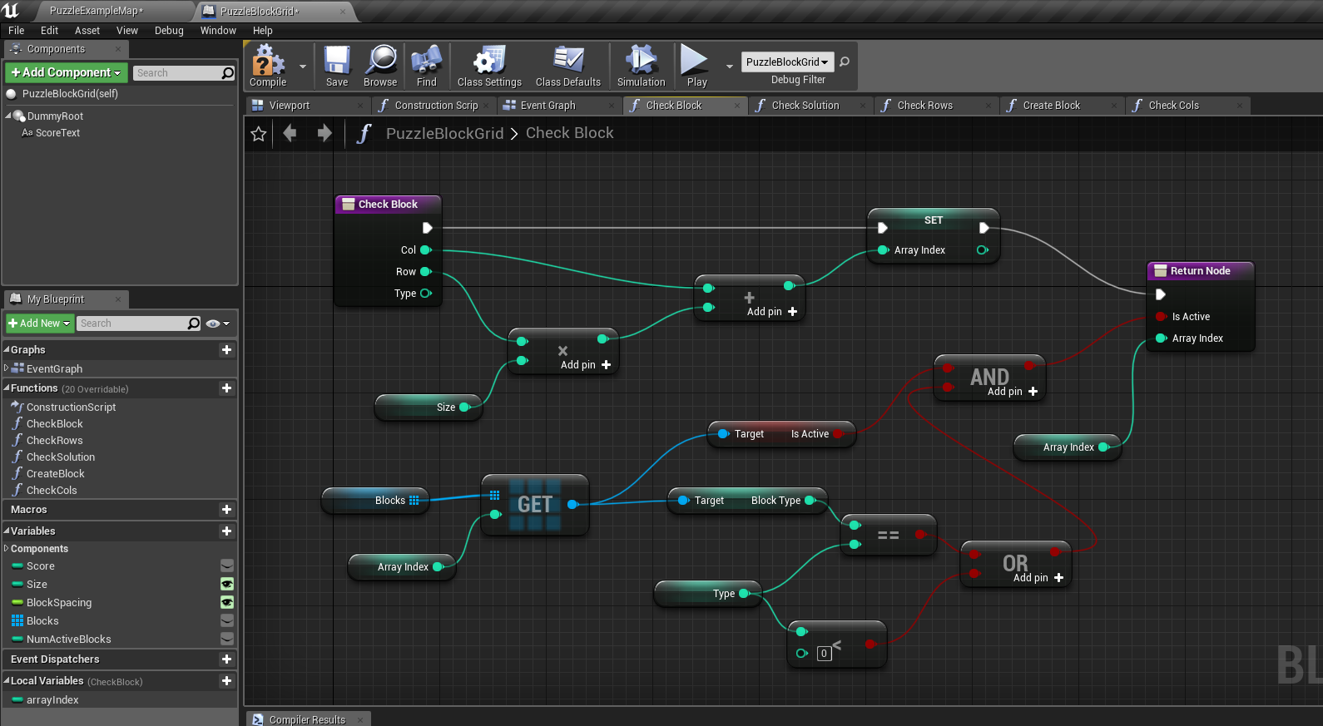
Add function: CheckBlock(Col,Row,Type)
Add local variable Array Index.
Compute arrayIndex which directly shows the index of [Col,Row] pair.
Type parameter is the blocktype of the block. For negative values the type check is ignored. (First time only)
You get access input parameter of a function by using a getter which can be accessed from the blueprints context menu.
CHECKBLOCK(3/5)

Slide 17
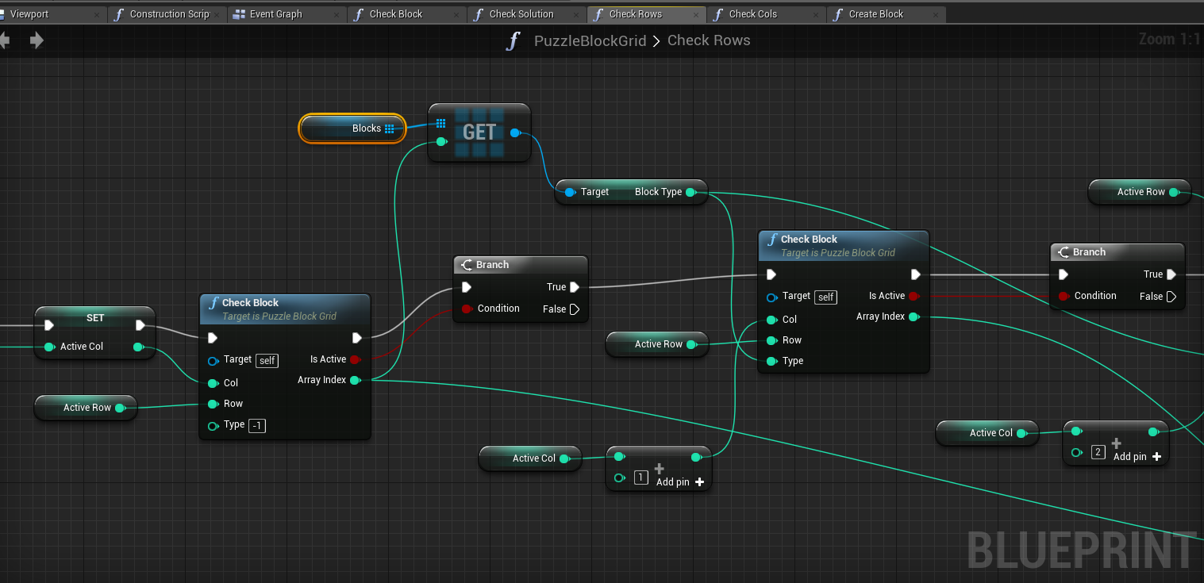
If the first [Row,Col] is not empty then get the blocktype and check for [Row,Col+1] and [Row,Col+2]
Beware! First CheckBlock has an input Type values as -1 to skip the BlockType check in the node.
CHECK ROWS (4/5)

Slide 18
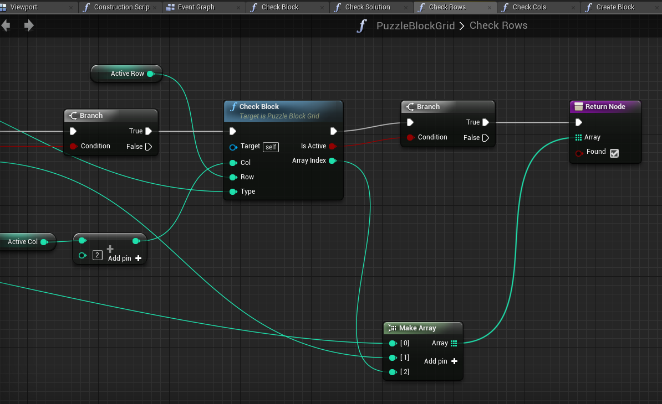
If all success then put all array indices into an array as pass as the output.
New Node: MakeArray which is used to build an array on the fly.
CHECK ROWS (5/5)

Slide 19
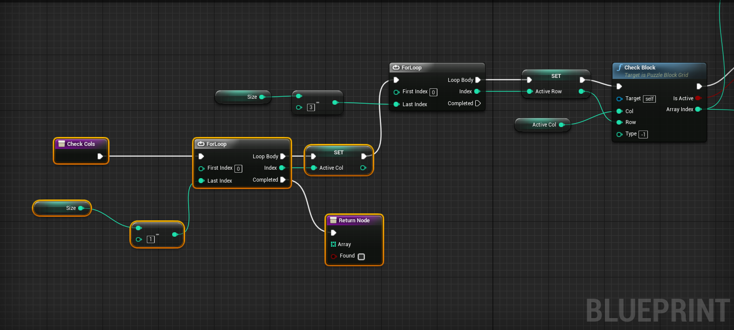
Make a copy of the function CheckRows and rename it to CheckCols.
This function does the same as CheckRows but it swaps the usages of ActiveCol and ActiveRows.
The the necessary changes to the rest of the function. (Not included in the following slides.)
CHECK COLS

Slide 20
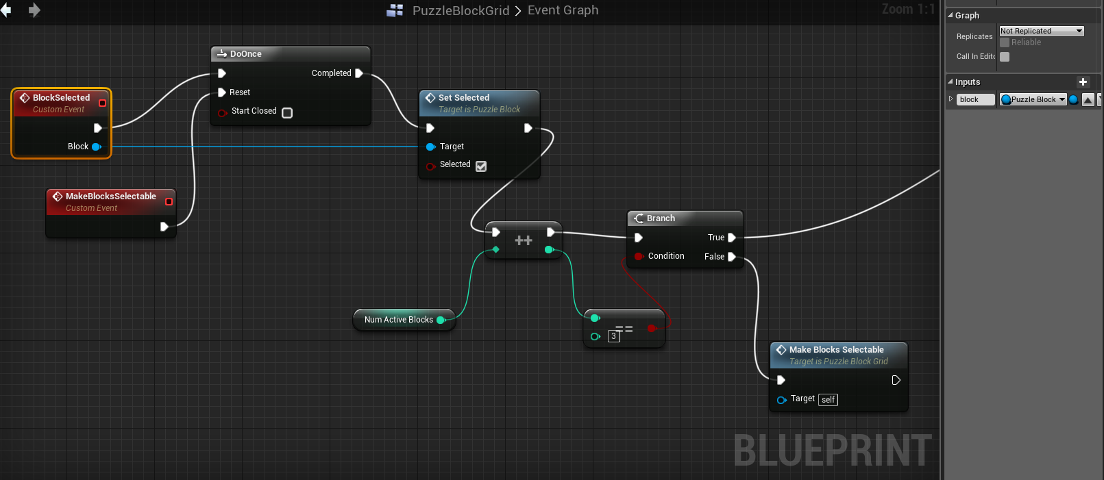
PUZZLEBLOCKGRID BLOCKSELECTED (1/3)
Add Custom Event: BlockSelected
Add an input variable of type PuzzleBlock object referance named Block.
Once BlockSelected called, it check for the solution if NumActiveBlocks have reached 3.
If not Selection of blocks will be enabled again. (Because DoOnce node would blok selecting again it if a group block breaking happens.)
Note: ++ is IncreamentInt node.

Slide 21
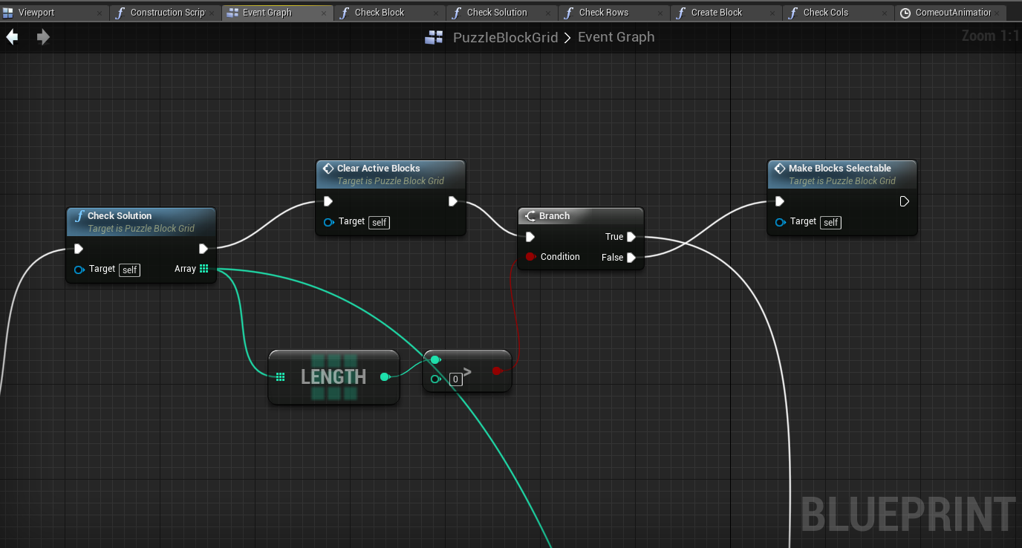
PUZZLEBLOCKGRID BLOCKSELECTED (2/3)
When selected blocks reach 3, then we check for the solution.
If there is a solution then out Array size will be greater than 0 (Size will be always 3 is our case.)
If the array is zero than there is no solution, thus we can re-enable selection of blocks.(Make Blocks Selectable retriggers Reset of DoOnce node.)

Slide 22
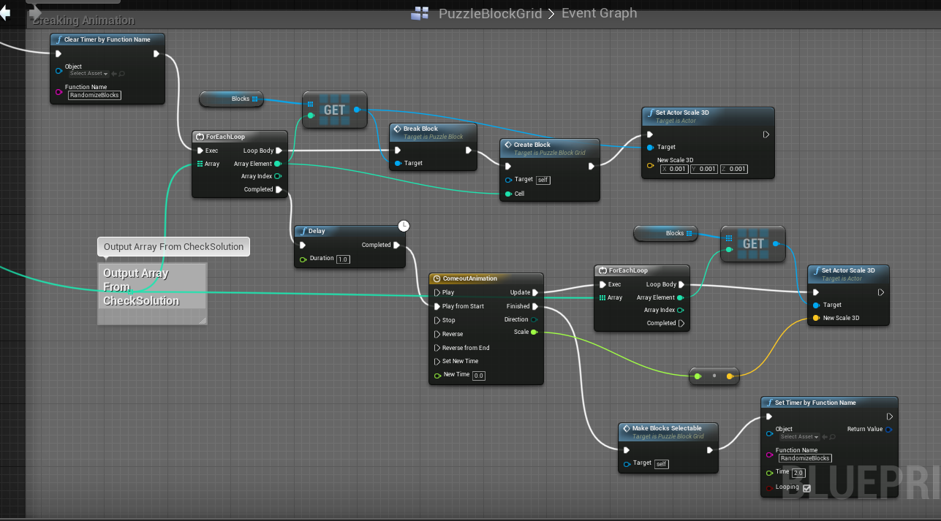
PUZZLEBLOCKGRID BLOCKSELECTED (3/3)
Here we create new blocks, break selected ones (Break like destructible mesh)
And start a popping-up animation.
When the animation ends, blocks became selectable again.
Consider using DestroyActor instead of BreakBlock function in the example below.

Slide 23
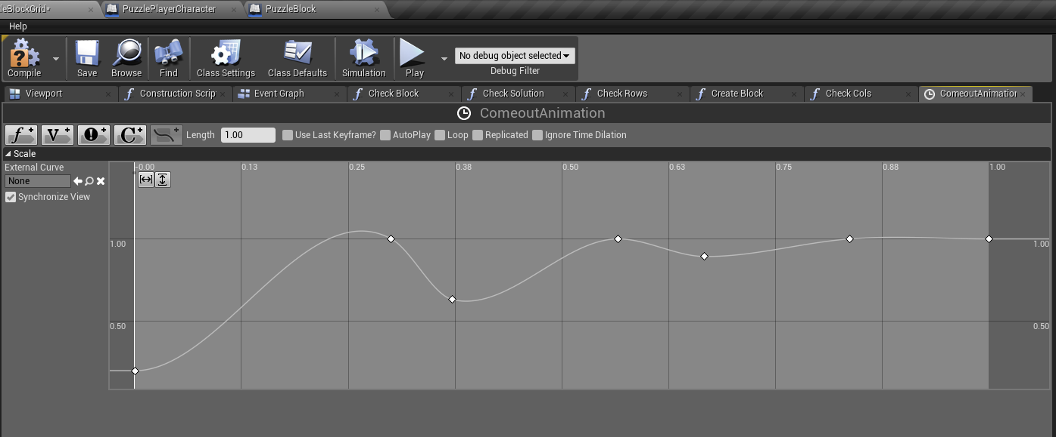
PUZZLEBLOCKGRID BLOCKSELECTED (POPPING-OUT ANIMATION)
1 second animation which affects the global scale of the newly added blocks.

Slide 24
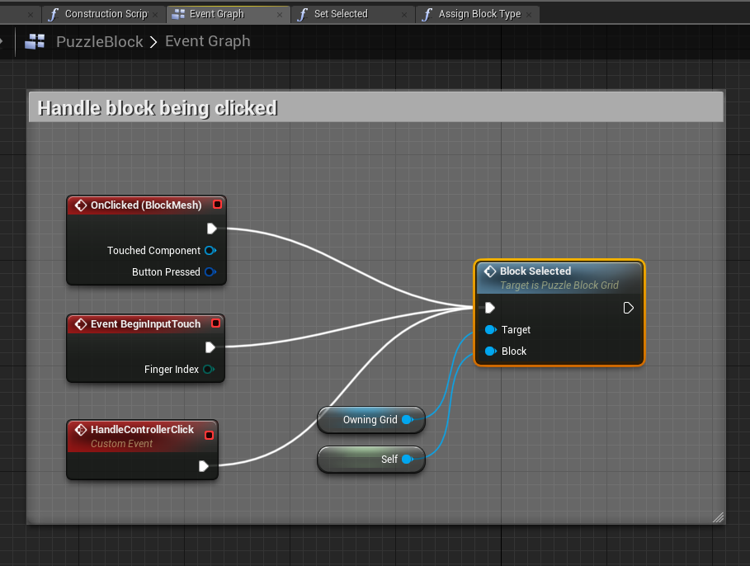
PUZZLEBLOCK
Change the OnClicked event of the block as follows:
This change will make the grid look for a solution whenever a block was activated.

